Slide 1
Prediction with Black-Scholes Model
Mike Ye

Slide 2
Goal
Black-Scholes Model to calculate Call and Put Options
Data
NASDAQ Composite
Consumer Price Index
Apple, AEY, and MBWM Stock Prices (Closing Prices)

Slide 3
Purpose
Calculate the put (sell) option and call (buy) option.
Put: buy a contract that reserve the rights for the investor to sell stocks at the expiration date, but not obligated.
Call: rights for the investor to buy stocks at the expiration data, but not obligated.
Analyze the stock market index to calculate put/call options to determine if investing in a certain stock will be profitable.

Slide 4
Black-Scholes Model
Stock Price
Strike/Exercise Price
Volatility (standard deviation)
Expiration Date
Risk Return Rate

Slide 5
Conclusion
Call Option:
Exercise Price < Stock Price
Put Option:
Exercise Price > Stock Price
In the market today, it is more profitable to invest in Call Options

Slide 6
Pre-Process Data
Julian Date
Discover trend of the market
Eliminate outliers
Training/Test Set
20% of data – Test Set

Slide 7
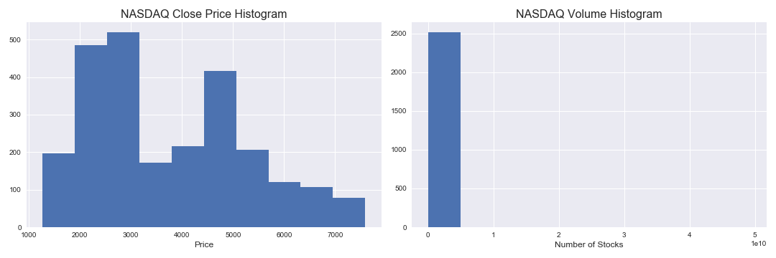
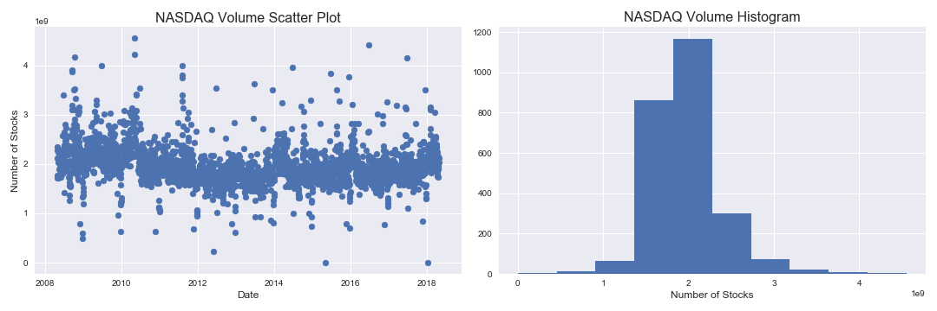
Pre-Process Data cont.

Slide 8
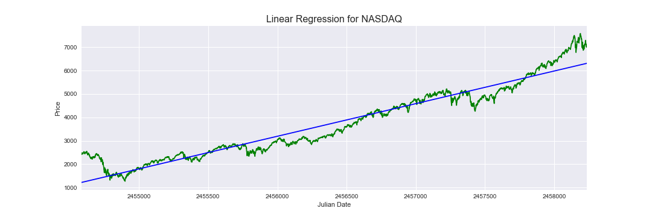
Benchmark Model
Create a Benchmark Model with Linear Regression

Slide 9
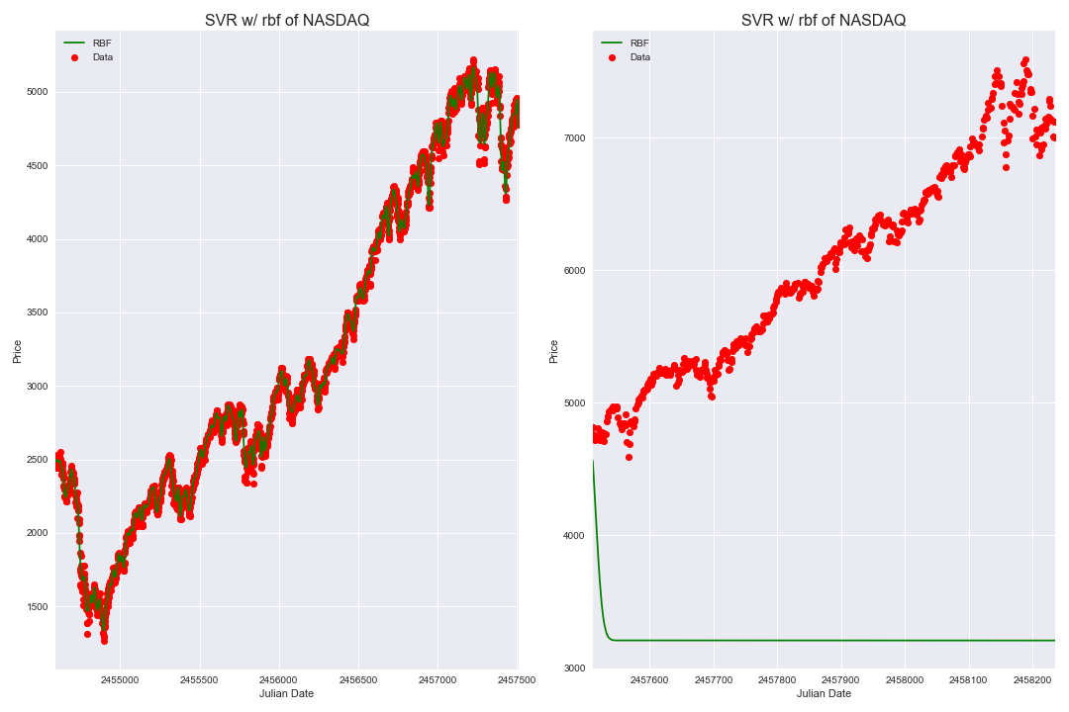
Support Vector Machine
Start Simple
Target – Closing Price
Feature – Dates
 | Result
Training | 0.99
Test | -12.73

Slide 10
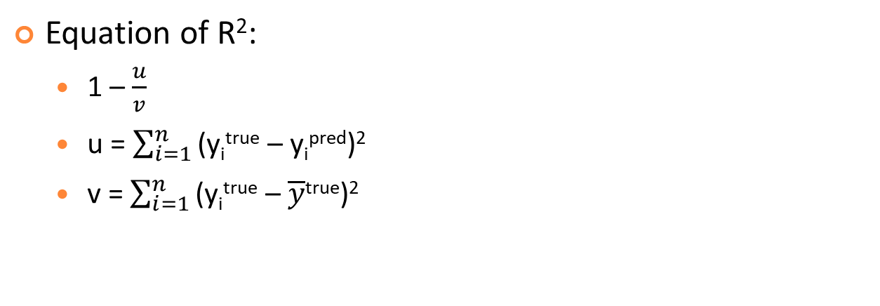
What’s Wrong?
Equation of R²:
1 – $\frac{u}{v}$
u = $\sum_{i=1}^{n}{\text{(}\text{yitrue}\text{ – }\text{yipred}\text{)2 }}$
v = $\sum_{i=1}^{n}{\text{(}\text{yitrue}\text{ – }\overline{y}\text{true}\text{)}\text{2} }$
 | Training | Test
u | 2,326,699.33 | 4,257,208,353.25
v | 2,366,401,109.22 | 309,955,259.03
Original Mean | 3204.98 | 6019.86
Predicted Mean | 3205.72 | 3228.17
R² | 1.00 | -12.73

Slide 11
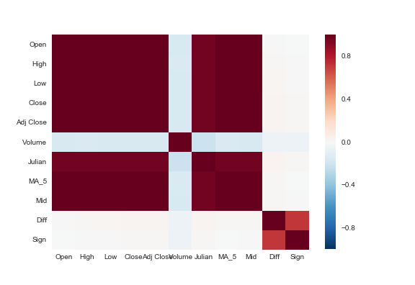
More Features
Moving Average ( 5 days )
Mid Price
Diff - difference between Mid and Close Prices
Sign – determine if Diff is positive or negative

Slide 12
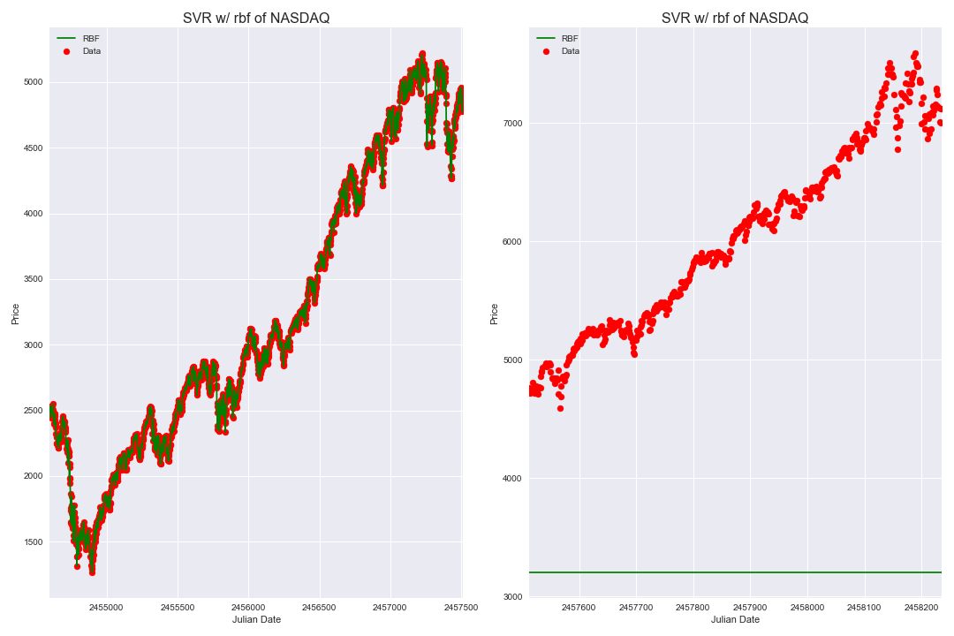
Results of More Features
Start Simple
Target – Closing Price
Feature – Added Features
 | Result
Training | 0.99
Test | -12.87

Slide 13

Remove Unnecessary Features
Start Simple
Target – Closing Price
Feature – Added Features
 | Result
Training | 0.99
Test | -12.87

Slide 14
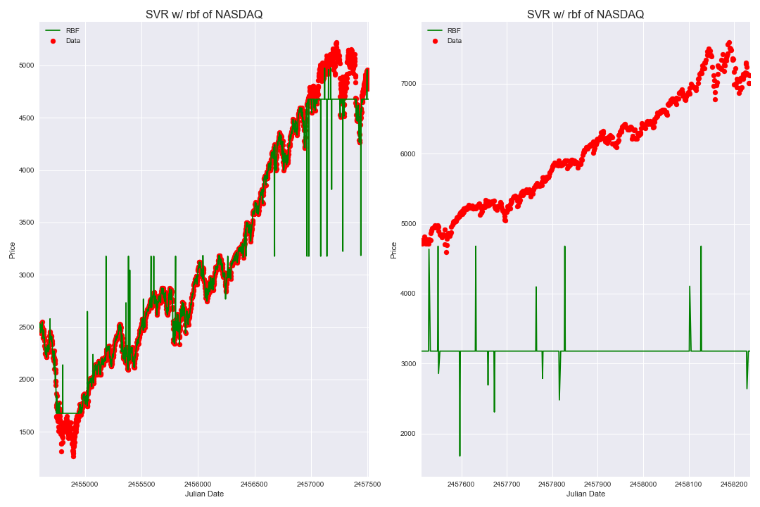
Experiment with Price Components Analysis (PCA)
Start Simple
Target – Closing Price
Feature – Added Features
 | Result
Training | 0.97
Test | -13.12

Slide 15
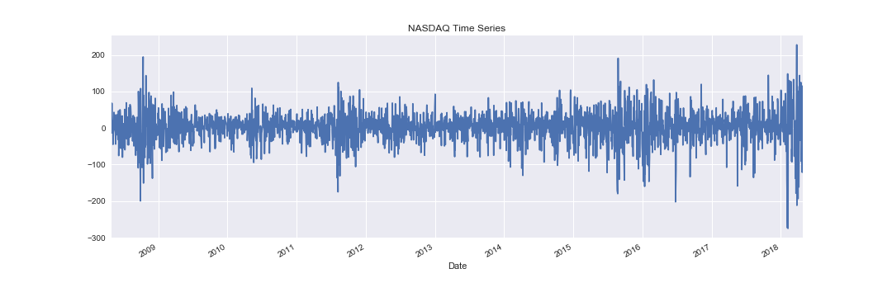
ARIMA Models
Check for stationarity

Slide 16
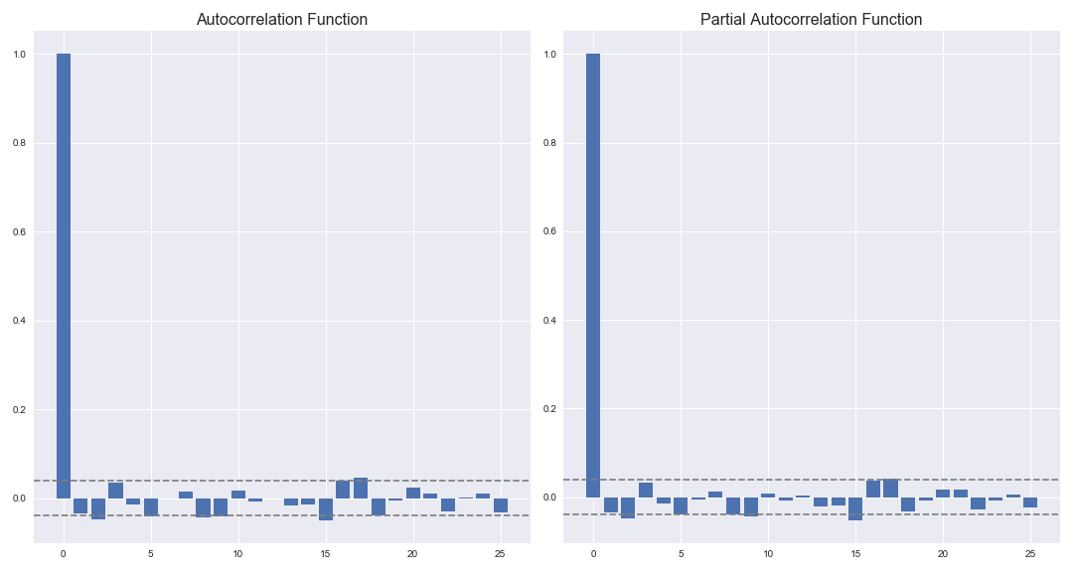
AR vs. MA Autoregressive Model and Moving Average
Plot Autocorrelation and Partial Autocorrelation Functions
Estimate the ‘q’ and ‘p’ value respectively

Slide 17
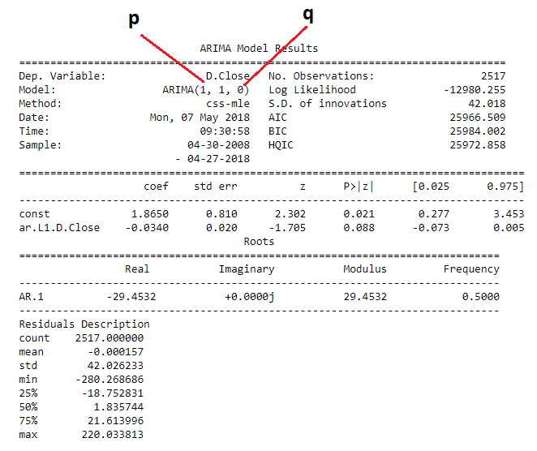
ARIMA Models Result
P-value
Confidence Interval
No imaginary number
Minimal AIC

Slide 18
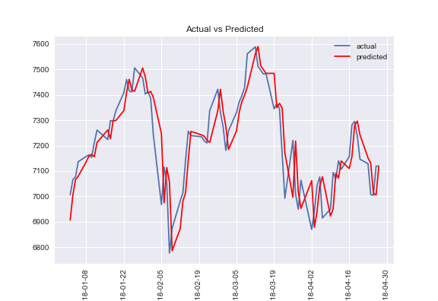
ARIMA Metrics
 | Results
MSE | 9304.464
MASE | 2.611
MAPE | 1.028
Mean Square Error
Mean Absolute Scaled Error
Mean Absolute Proportional Error

Slide 19
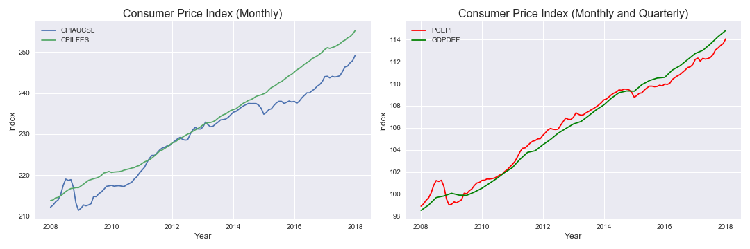
Consumer Price Index (CPI)
CPIAUCSL - Consumer Price Index for All Urban Consumers
CPILFESL - Consumer Price Index for All Urban Consumers: All Items Less Food and Energy (exclude food and energy)
PCEPI - Personal Consumption Expenditures
GDPDEF - Gross Domestic Product: Implicit Price Deflator

Slide 20
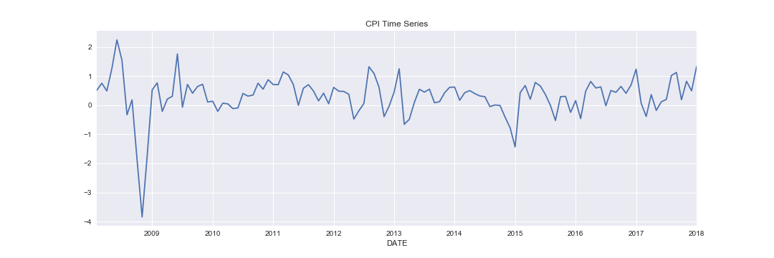
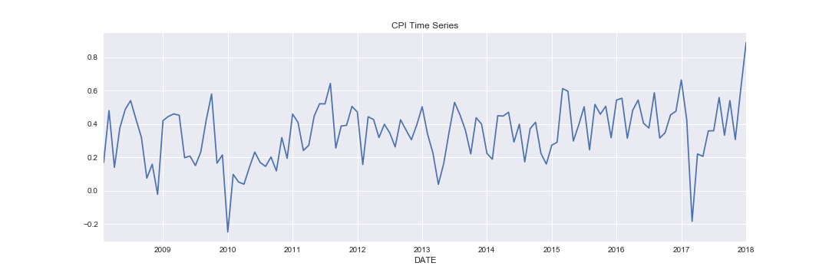
CPIAUCSL vs. CPILFESL
CPIAUCSL
CPILFESL

Slide 21
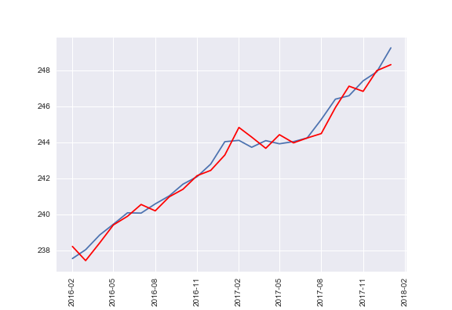
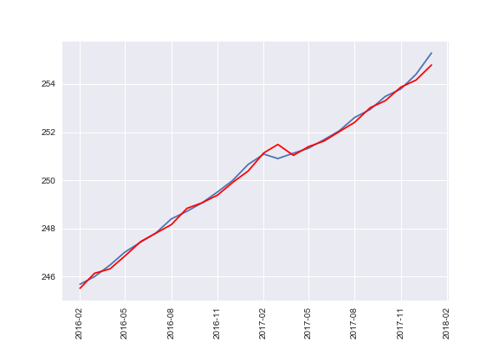
CPIAUCSL vs. CPILFESL cont.
CPIAUCSL
CPILFESL
 | Results
MSE | 0.242
MASE | 0.736
MAPE | 0.170
 | Results
MSE | 0.043
MASE | 0.460
MAPE | 0.061

Slide 22
Risk Free Return
Risk Free Return = Stock Market Return – Inflation Rate
Inflation Rate | 1.823
Stock Market Return | 1.951
Volatility
Volatility of 10 days
Volatility of 20 days
Volatility of 30 days

Slide 23
Results of Black Scholes
Call Option
Put Option
Time = 1 month
Exercise Price = 0.95%
Exercise Price = EP
Time = 1 month
Exercise Price = 1.05%
Test the model with Apple Stocks –
volatility of 30 days
Stock price = $183.83 (Close Price of 2018-05-04)
 | Options | EP = 0.95 | EP = 1.05
Call | 13.61 | 4.42 | 0.00
Put | 2.54 | 0.00 | 1.94

Slide 24
Limitations -> Future Notes
Limited Features
Last 10 years of data
Plan for future:
Learn more about the market to construct better features
Get data from greater time period or lesser time period

